Slide 1
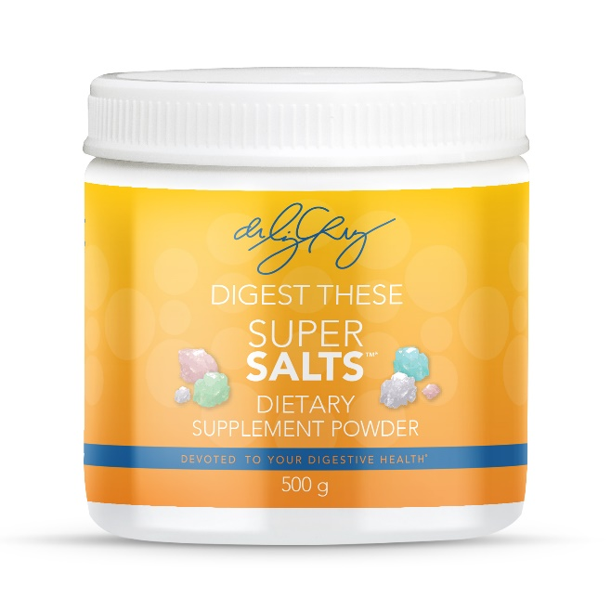
Dr. Liz Cruz, Sought After
Digestive Health Expert
Electrolytes
101
Just a few of the essential electrolytes most commonly found in the human body are sodium, potassium, bicarbonate, calcium, and magnesium all of which are found in the Dr. Liz Cruz Super Salts™.
$35.00
How are these different than table salt?
There is a tremendous difference between table salt and electrolyte salts. Table salt is "chemically cleaned" and reduced to only sodium and chloride. Important minerals and trace elements are removed. The remaining salt is now poison to the body. You should avoid white table salt and in turn replace it with drinking electrolyte salts and using pure forms of salt on your food like sea salt, Himalayan salt, kosher salt, or Real Salt.
How do you take Super Salts™?
Super Salts™ are to be taken with water, not put on food. We suggest putting one scoop of salts (1 teaspoon) in every 26 – 32-ounce bottle of water you drink. If you cannot do this because it is too salty tasting, start by adding ¼ scoop of salts to 26 – 32 ounces of water and then increase from there once you get used to it.
If you are constipated, the salts make a great mini-colonic formula. Add a whole scoop of salts to 3 ounces of water and shoot it – follow that with drinking 26 ounces of water within a 10 – 15-minute time period. Let the pooping begin!
To ensure that Dr. Liz Cruz and her family are fully hydrated, they drink their Super Salts™. To order yours, either speak with a staff member, or order online at drlizcruz.com.
What are electrolytes / why are they important?
Electrolytes are salts that are responsible for keeping the body properly hydrated so the muscles and nerves can function properly. Electrolytes are analogous to the motor oil in your car—they don’t make the engine run, but they’re absolutely necessary to keep everything running smoothly. Proper functioning of the digestive, nervous, cardiac, and muscular systems depends on adequate electrolyte levels.
What are Super Salts™?
Super Salts™ contain the four key electrolyte salts that are made up in the body allowing the body to replenish exactly what it is losing on a daily basis. Specifically, they may aid in the reduction of dietary and metabolic acidity helping to maintain the alkaline design of the body. They have been known to help reduce or completely eliminate sugar and salt cravings.
Why should I consider taking Super Salts™?
The human body is composed mostly of salt water. Have you ever tasted your sweat or your tears? They are salty! Your body is a giant saltwater bag and all day long you are losing salt water, when you urinate, when you sweat or when you talk. If you do not replace this salt water your body becomes very dehydrated. Plus, when we are well-hydrated, we are able to release toxic internal wastes such as harmful chemicals, urea and ammonia.
These statements have not been evaluated by the Food and Drug Administration.
These products are not intended to diagnose, treat, cure, or prevent any disease.

